Slide 1
Submitted To Md Imran Hossain Assistant Professor Dept. Of ICT Comilla University

Slide 2
Submitted By Iftekhar Fahim ID : 11809049 Dept. Of ICT Comilla University

Slide 3
Receiver of basic monochrome Television sysem

Slide 4
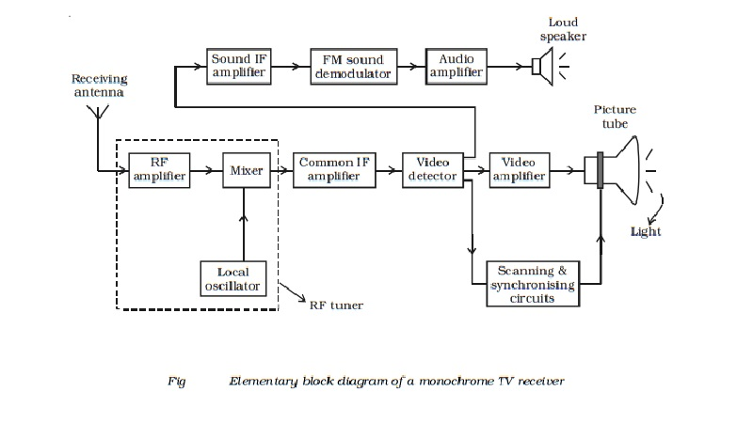

Slide 5
This section consists of RF amplifier, mixer and local oscillator and is normally mounted on a separate sub-chassis, called the ‘Front End’ or ‘RF Tuner’. Either tubes or transistors can be used. With tubes, local oscillator and mixer functions are usually combined in one stage called the ‘frequency converter’. The purpose of the tuner unit is to amplify both sound and picture signals picked up by the antenna and to convert the carrier frequencies and their associated bands into the intermediate frequencies and their sidebands.
The receiver uses superhetrodyne principle as used in radio receivers.
In principle an RF amplifier is not necessary and signal could be fed directly to the tuned input circuit of the mixer. However, the problems of a relatively weak input signal with low signal to noise ratio, local oscillator radiation and image rejection are such, that a stage of amplification ahead of the mixer is desirable.

Slide 6

Thank You

